Slide 1
Lab Exercise: 4
Iimplementation of Breadth First Search and Depth first Search

Slide 2
Breadth first Search

Slide 3
Breadth First Search
Breadth-first search (BFS) is an algorithm that is used to graph data or searching tree or traversing structures.
The algorithm efficiently visits and marks all the key nodes in a graph in an accurate breadthwise fashion.
This algorithm selects a single node (initial or source point) in a graph and then visits all the nodes adjacent to the selected node. BFS accesses these nodes one by one.
Once the algorithm visits and marks the starting node, then it moves towards the nearest unvisited nodes and analyses them.
Once visited, all nodes are marked. These iterations continue until all the nodes of the graph have been successfully visited and marked.

Slide 4
Algorithm
The BFS algorithm works as follows:
Create a queue
Mark each new node as visited and put that node into the queue
While Queue is non-empty
Remove the head of Queue
Mark and enqueue all (unvisited) neighbours

Slide 5
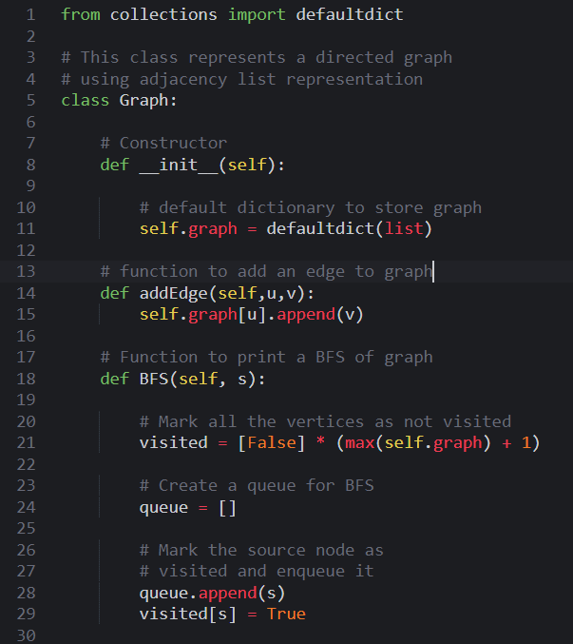
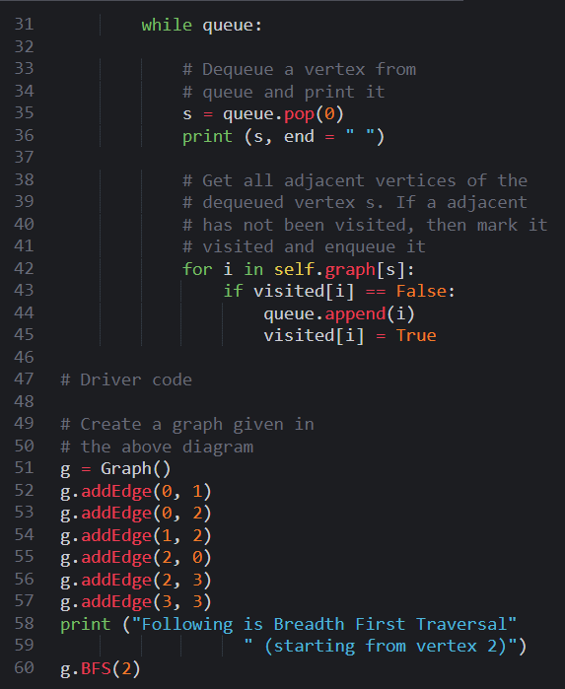
Code

Slide 6

Code
Output:

Slide 7
Applications of Breadth First Search
Some applications of BFS are:
Un-weighted Graphs: BFS algorithm can easily create the shortest path and a minimum spanning tree to visit all the vertices of the graph in the shortest time possible with high accuracy.
P2P Networks: BFS can be implemented to locate all the nearest or neighbouring nodes in a peer to peer network. This will find the required data faster.
Network Broadcasting: A broadcasted packet is guided by the BFS algorithm to find and reach all the nodes it has the address for.

Slide 8
Depth first Search

Slide 9
Depth first Search
Depth-first search (DFS) is an algorithm for searching a graph or tree data structure.
The algorithm starts at the root (top) node of a tree and goes as far as it can down a given branch (path), then backtracks until it finds an unexplored path, and then explores it.
The data structure which is being used in DFS is stack.
In DFS, the edges that leads to an unvisited node are called discovery edges while the edges that leads to an already visited node are called block edges.

Slide 10
Algorithm
The DFS algorithm works as follows:
Start by putting any one of the graph's vertices on top of a stack.
Take the top item of the stack and add it to the visited list.
Create a list of that vertex's adjacent nodes.
Add the ones which aren't in the visited list to the top of the stack.
Keep repeating steps 2 and 3 until the stack is empty.

Slide 11
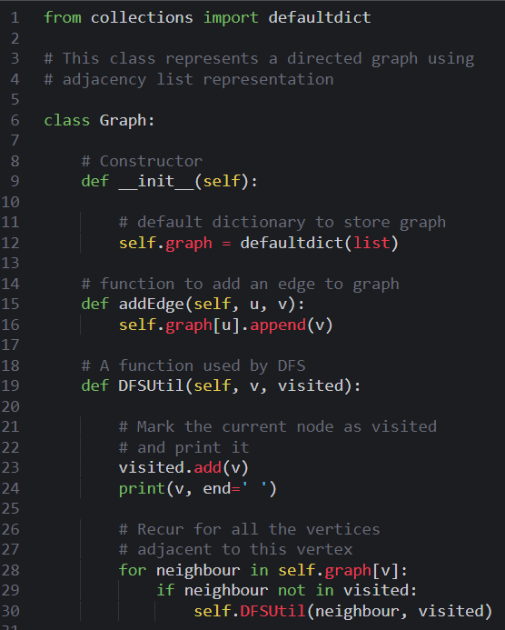
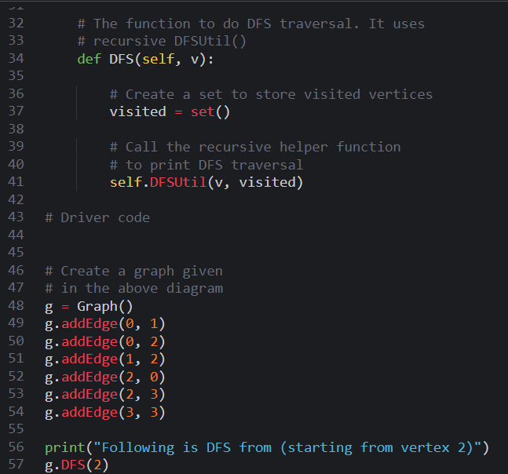
Code

Slide 12

Code
Output:

Slide 13
Applications of Depth First Search
Some applications of DFS are:
Weighted Graph: In a weighted graph, DFS graph traversal generates the shortest path tree and minimum spanning tree.
Detecting a Cycle in a Graph: A graph has a cycle if we found a back edge during DFS. Therefore, we should run DFS for the graph and verify for back edges.
Solving Puzzles with Only One Solution: DFS algorithm can be easily adapted to search all solutions to a maze by including nodes on the existing path in the visited set.

Slide 14
Difference Between Breadth First Search And Depth First Search
Breadth First Search
Depth First Search
BFS finds the shortest path to the destination.
It uses a queue to keep track of the next location to visit.
BFS traverses according to tree level.
It requires more memory as compare to DFS.
This algorithm gives the shallowest path solution.
There is no need of backtracking in BFS.
You can never be trapped into finite loops.
DFS goes to the bottom of a subtree, then backtracks.
It uses a stack to keep track of the next location to visit.
DFS traverses according to tree depth.
It requires less memory as compare to BFS.
This algorithm doesn’t guarantee the shallowest path solution.
There is a need of backtracking in DFS.
You can be trapped into infinite loops.

Slide 15
Thank You
VIVEK BURUGUDDA RA1911003010316
HARSHIL AGARWAL RA1911003010325
RITESH RAI RA1911003010333
PUNEET SHARMA RA1911003010331
PRAKHAR VIJAY RA1911003010337

